Slide 1
Green School Committee Updates

Slide 2
America Recycles Day:
Collected 5 large bins + 1 Extra Large Bin of Paper, Cardboard and plastic/cans
Was asked to put a hold on the recycling effort from the admin team for now…???
I still collect all of my recycling and put it to the side and dump it myself

Slide 3
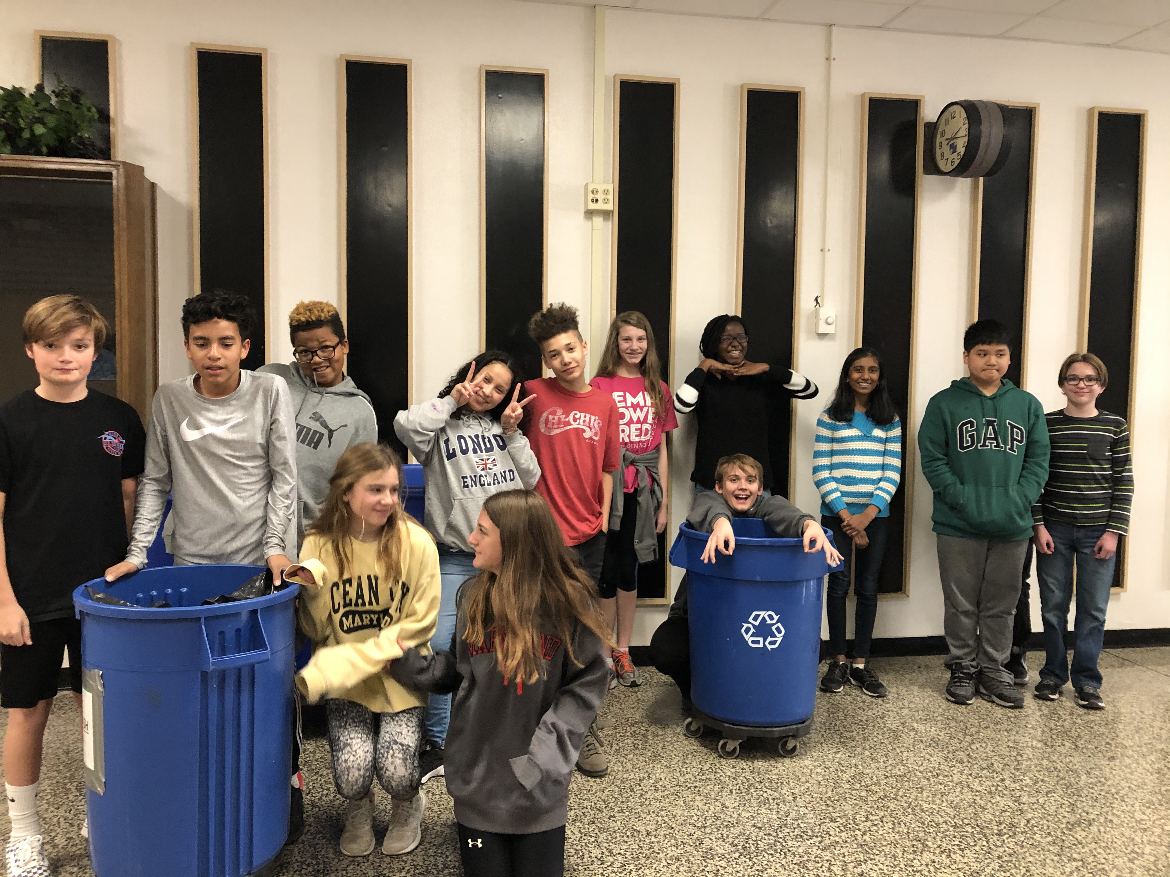
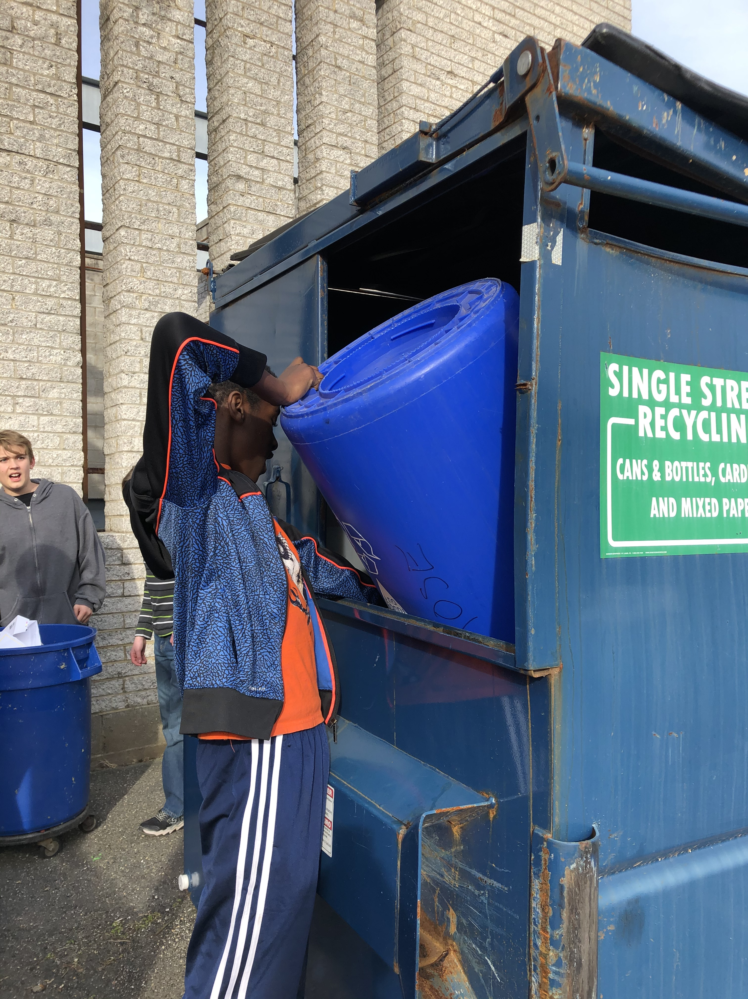
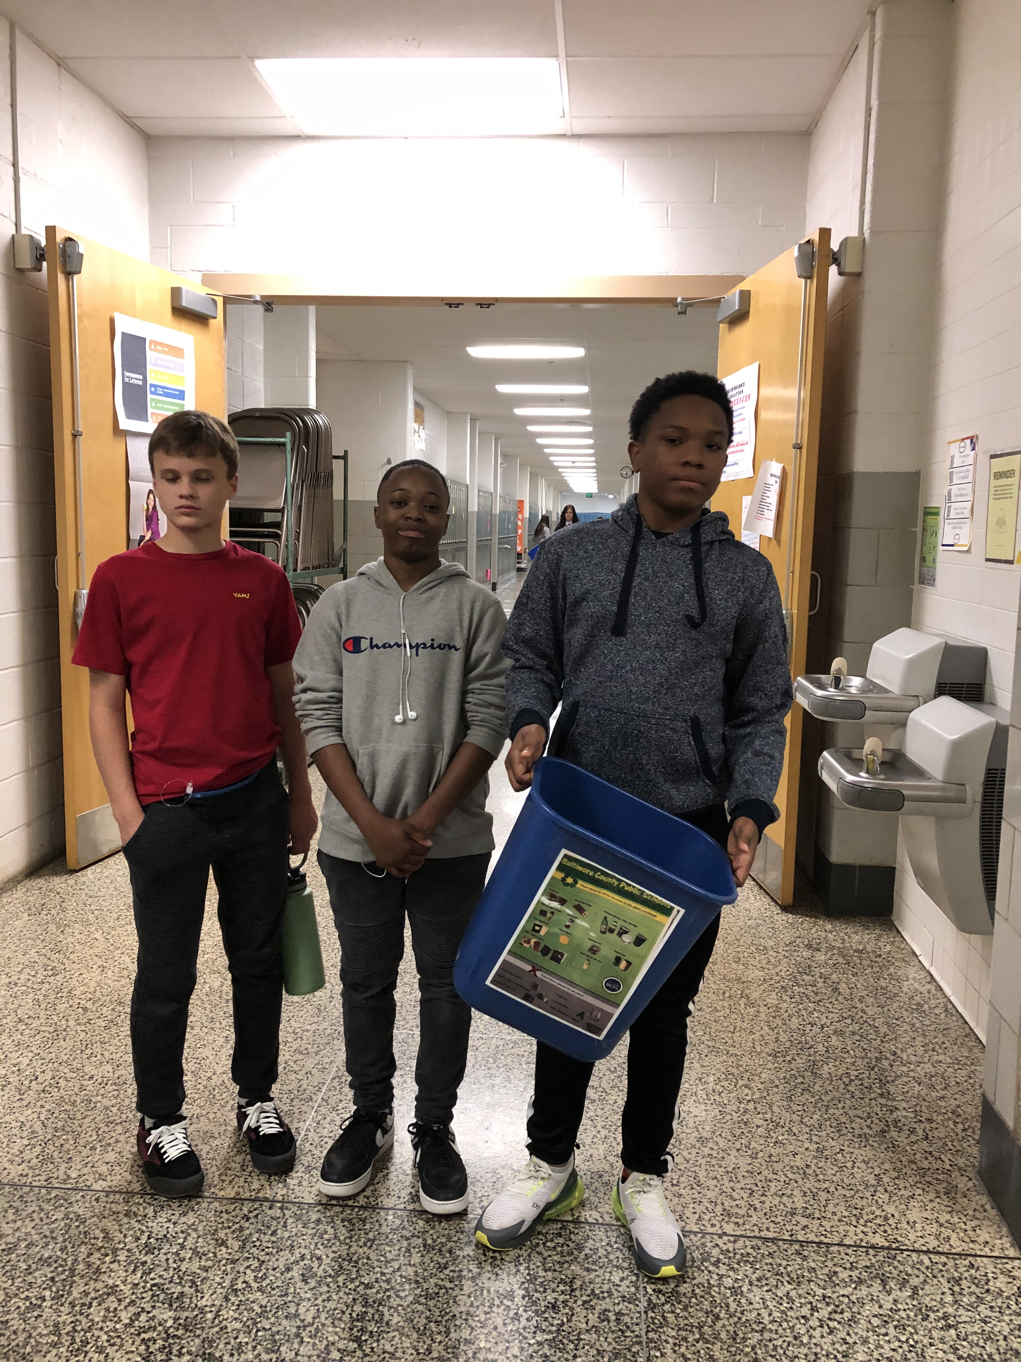
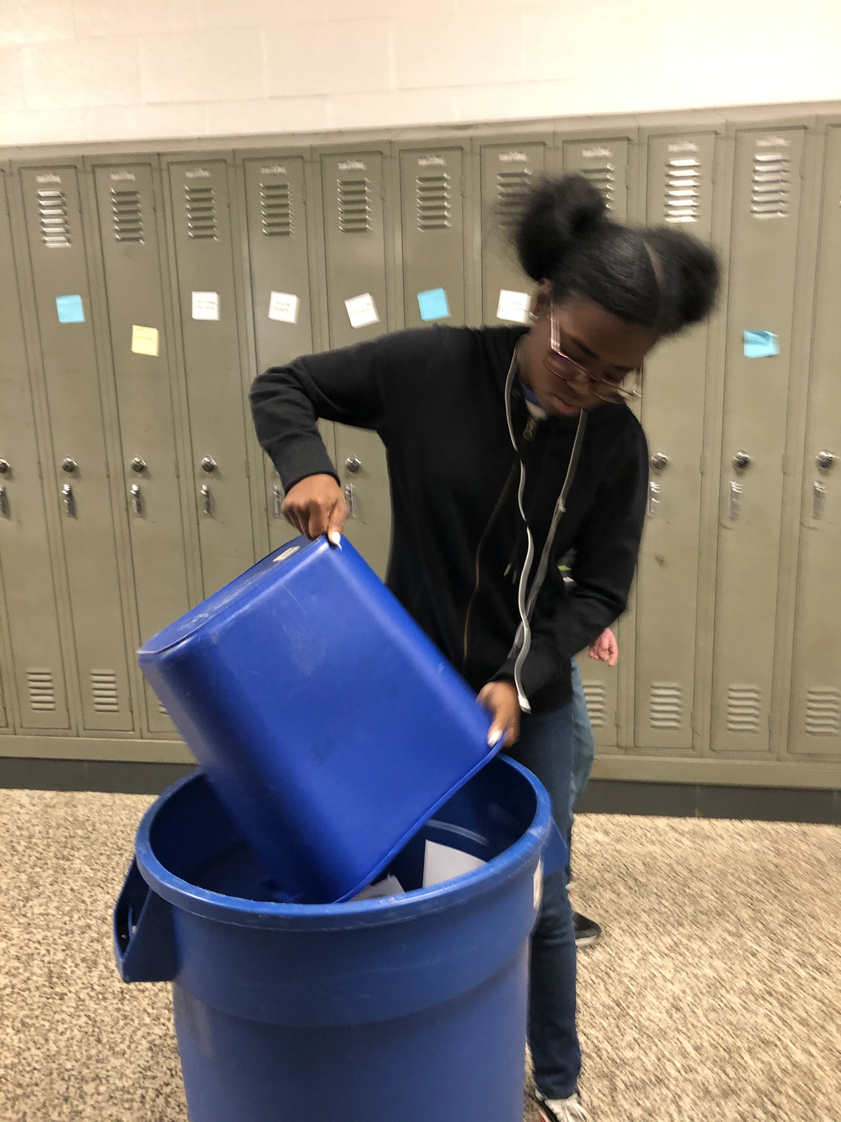

Slide 4
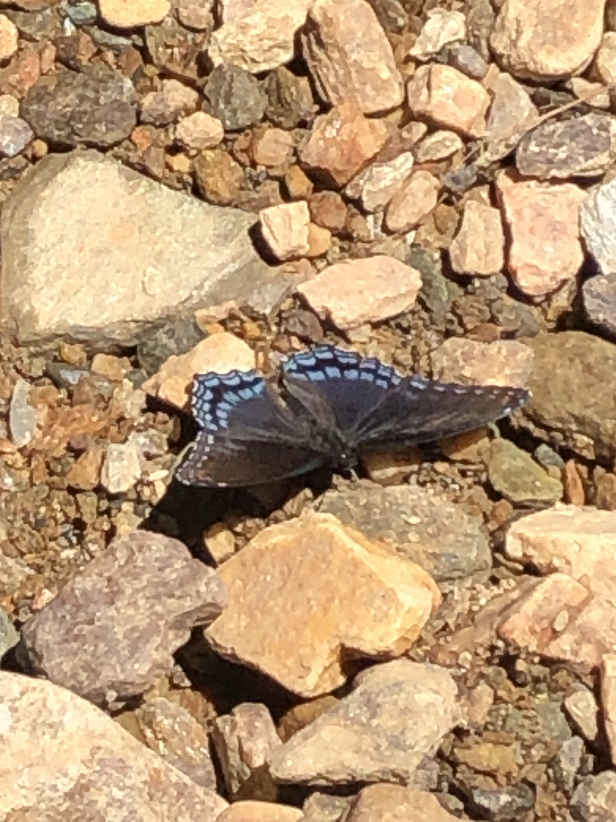
Stream Clean up
Created 5 leaf packets and placed out in the
stream behind the school
Cleaned up 4 small garbage bags full of trash from the stream and school yard
Will be rechecking the leaf packets in the spring to see what kind of habitat has procreated.

Slide 5
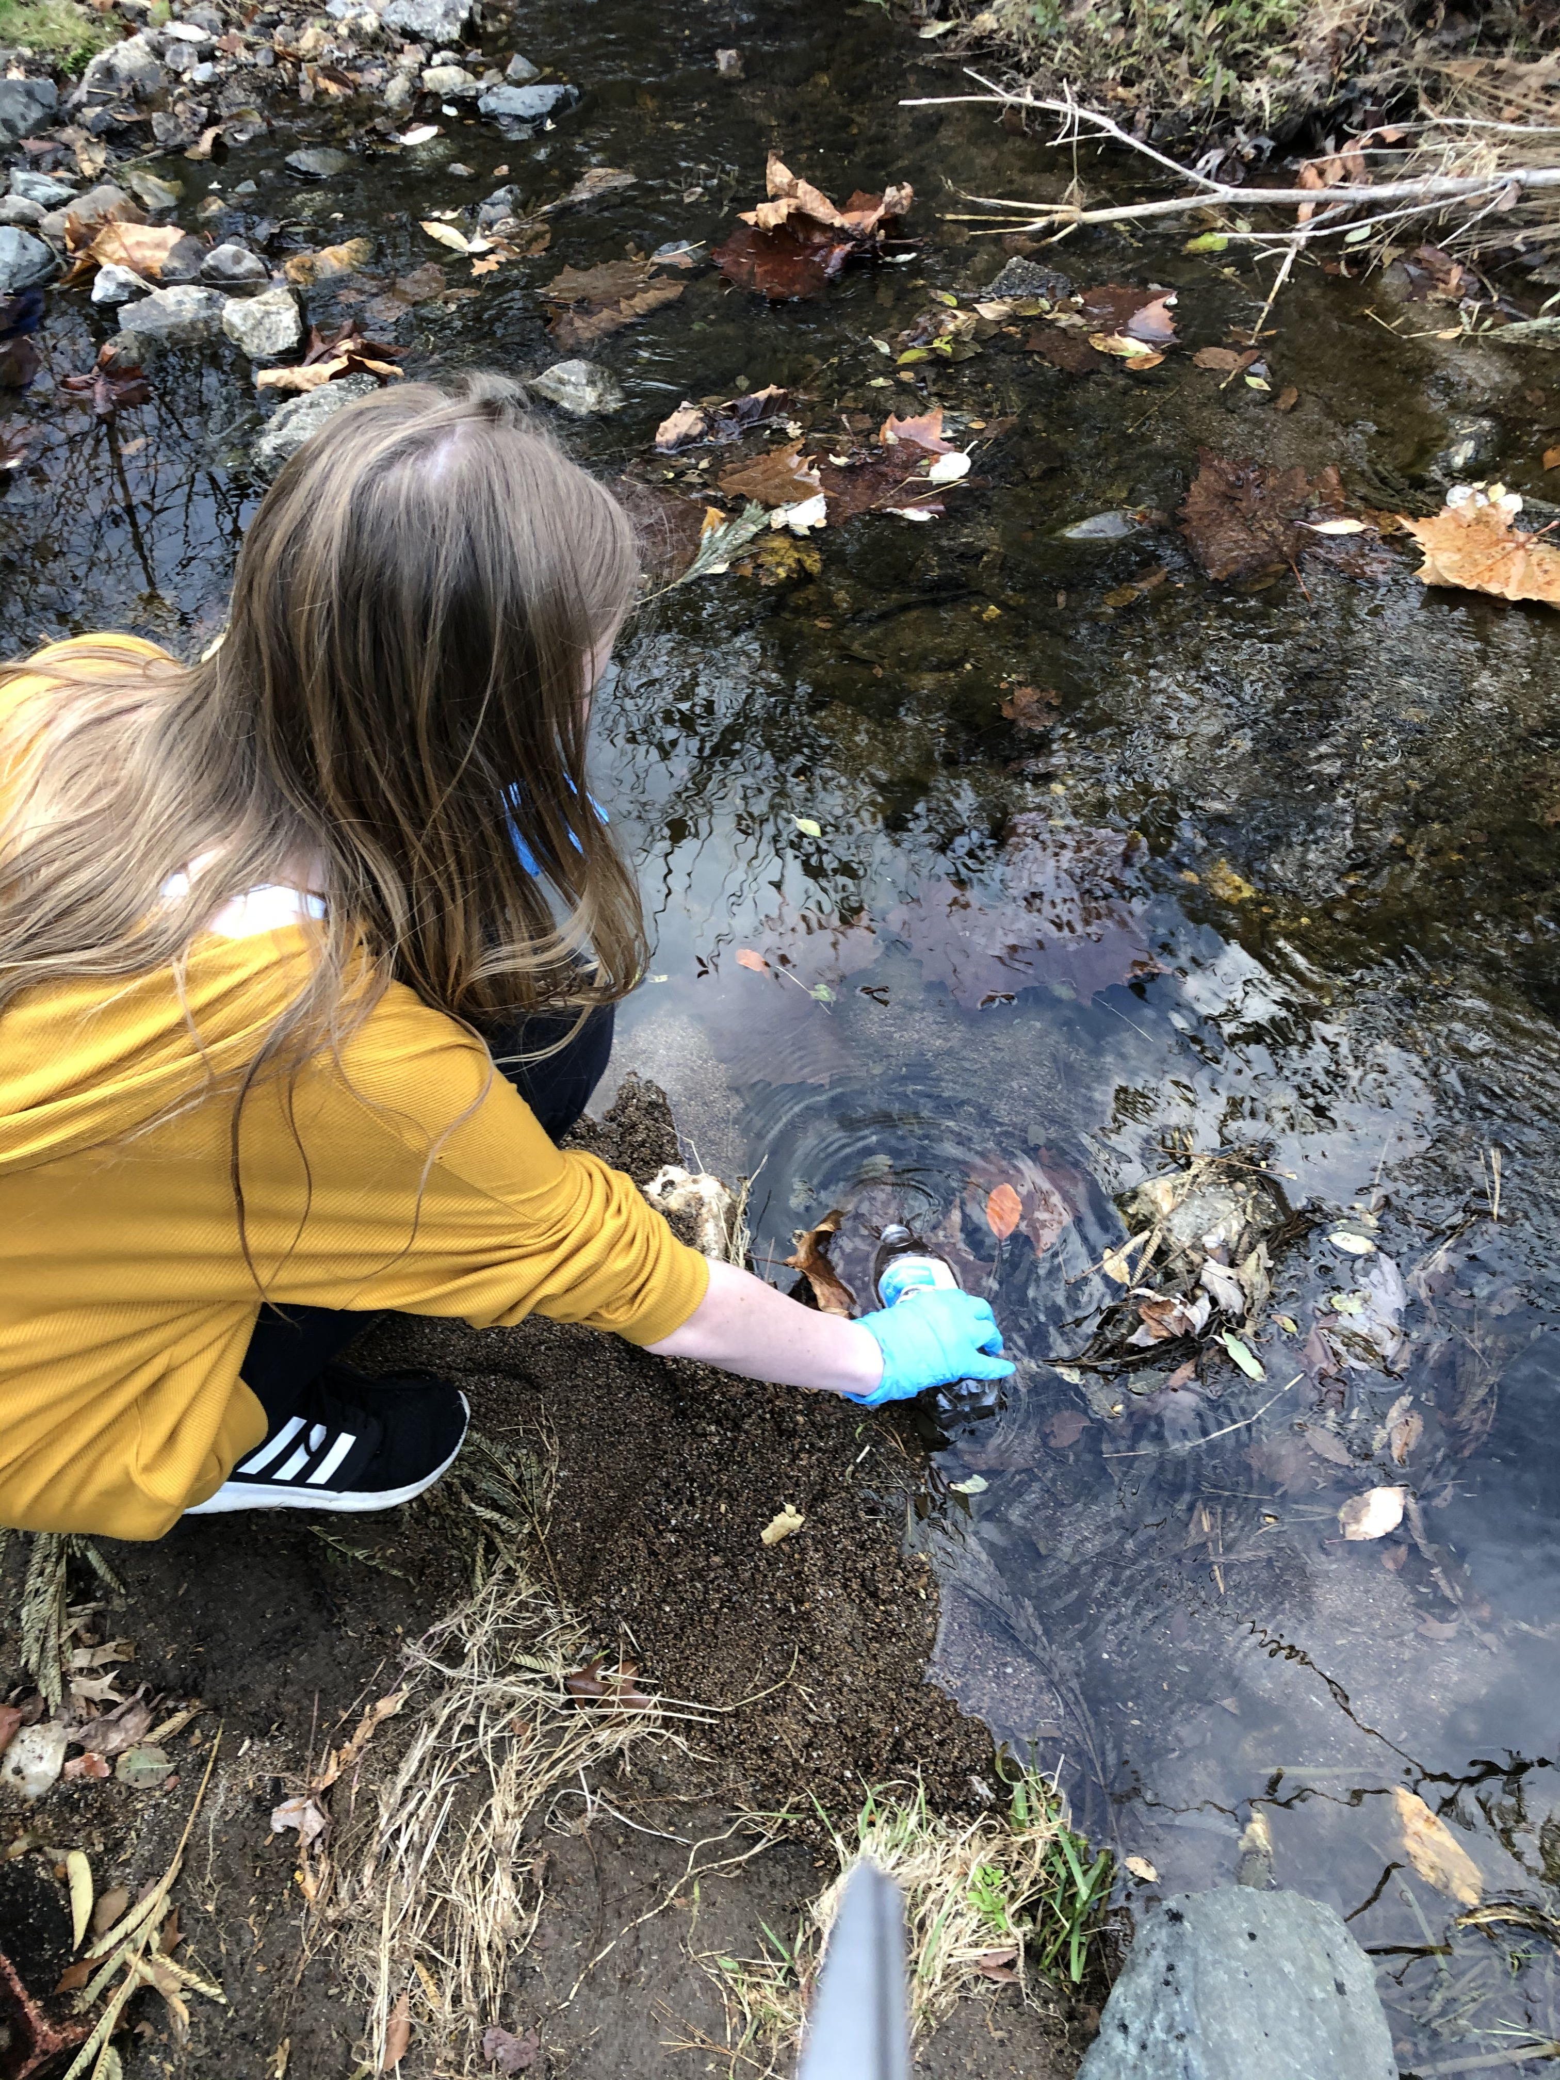
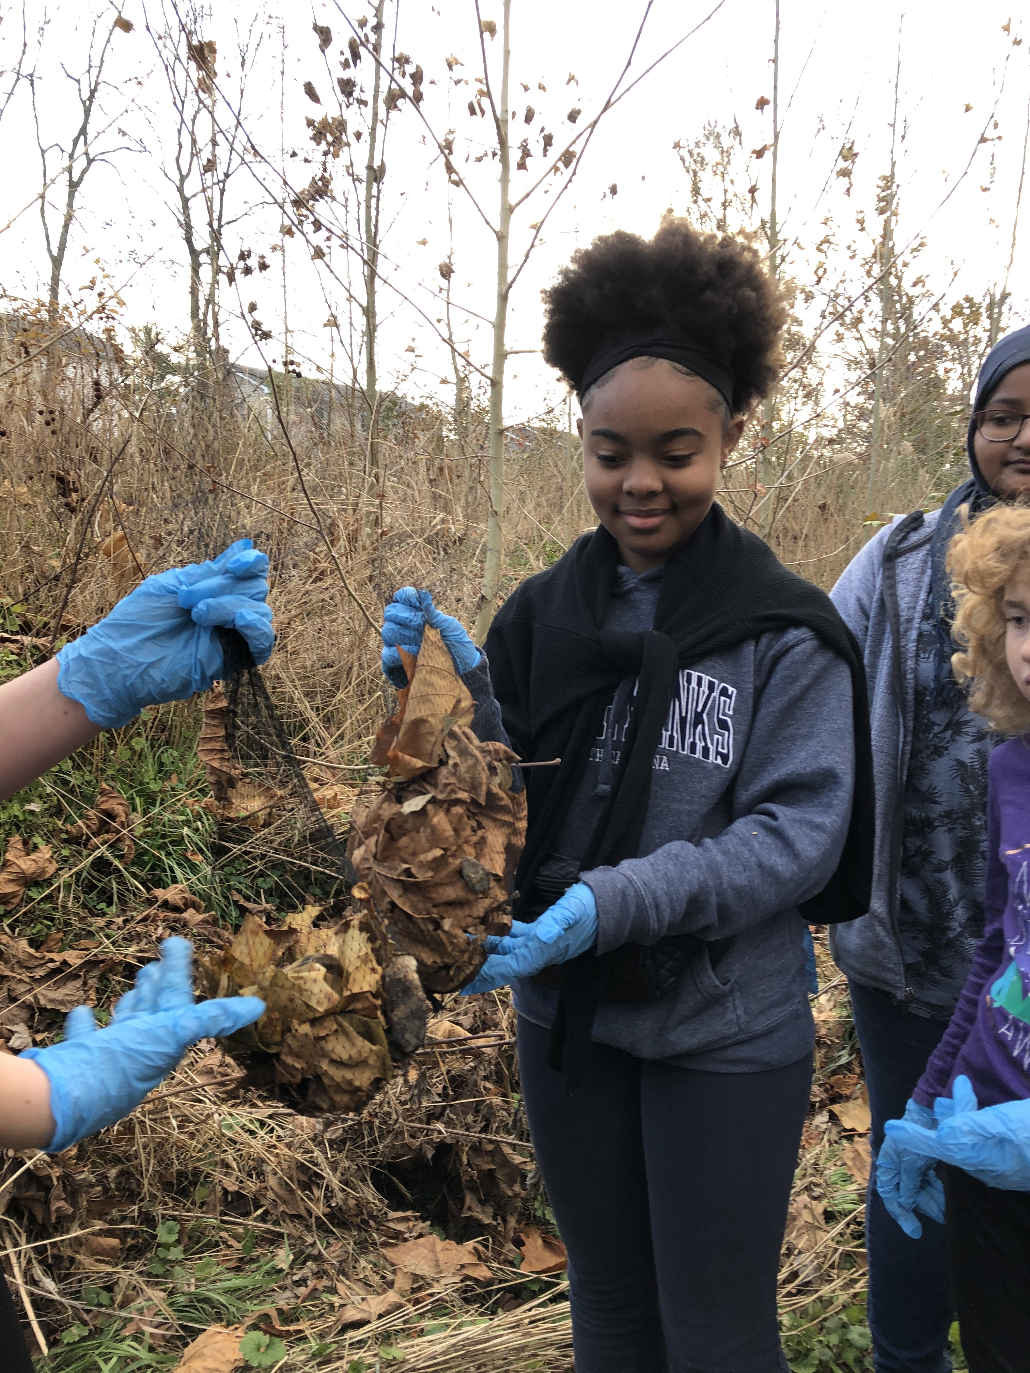
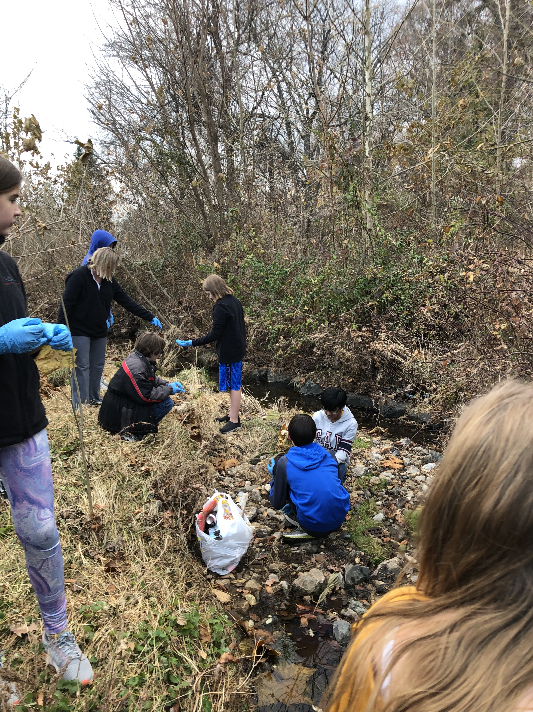
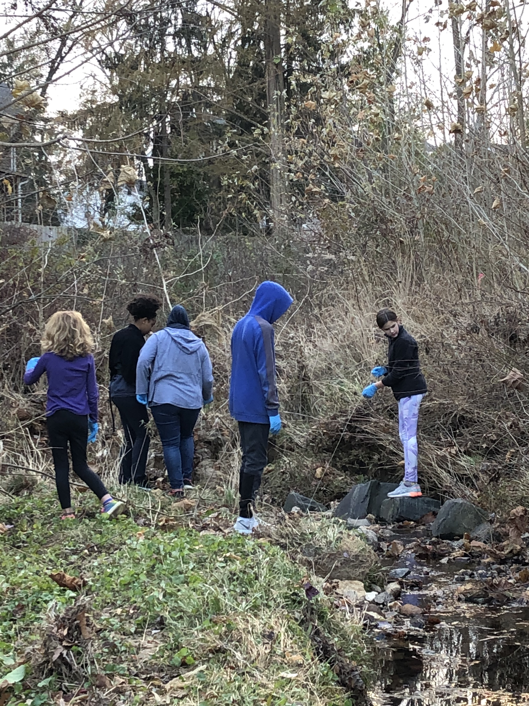
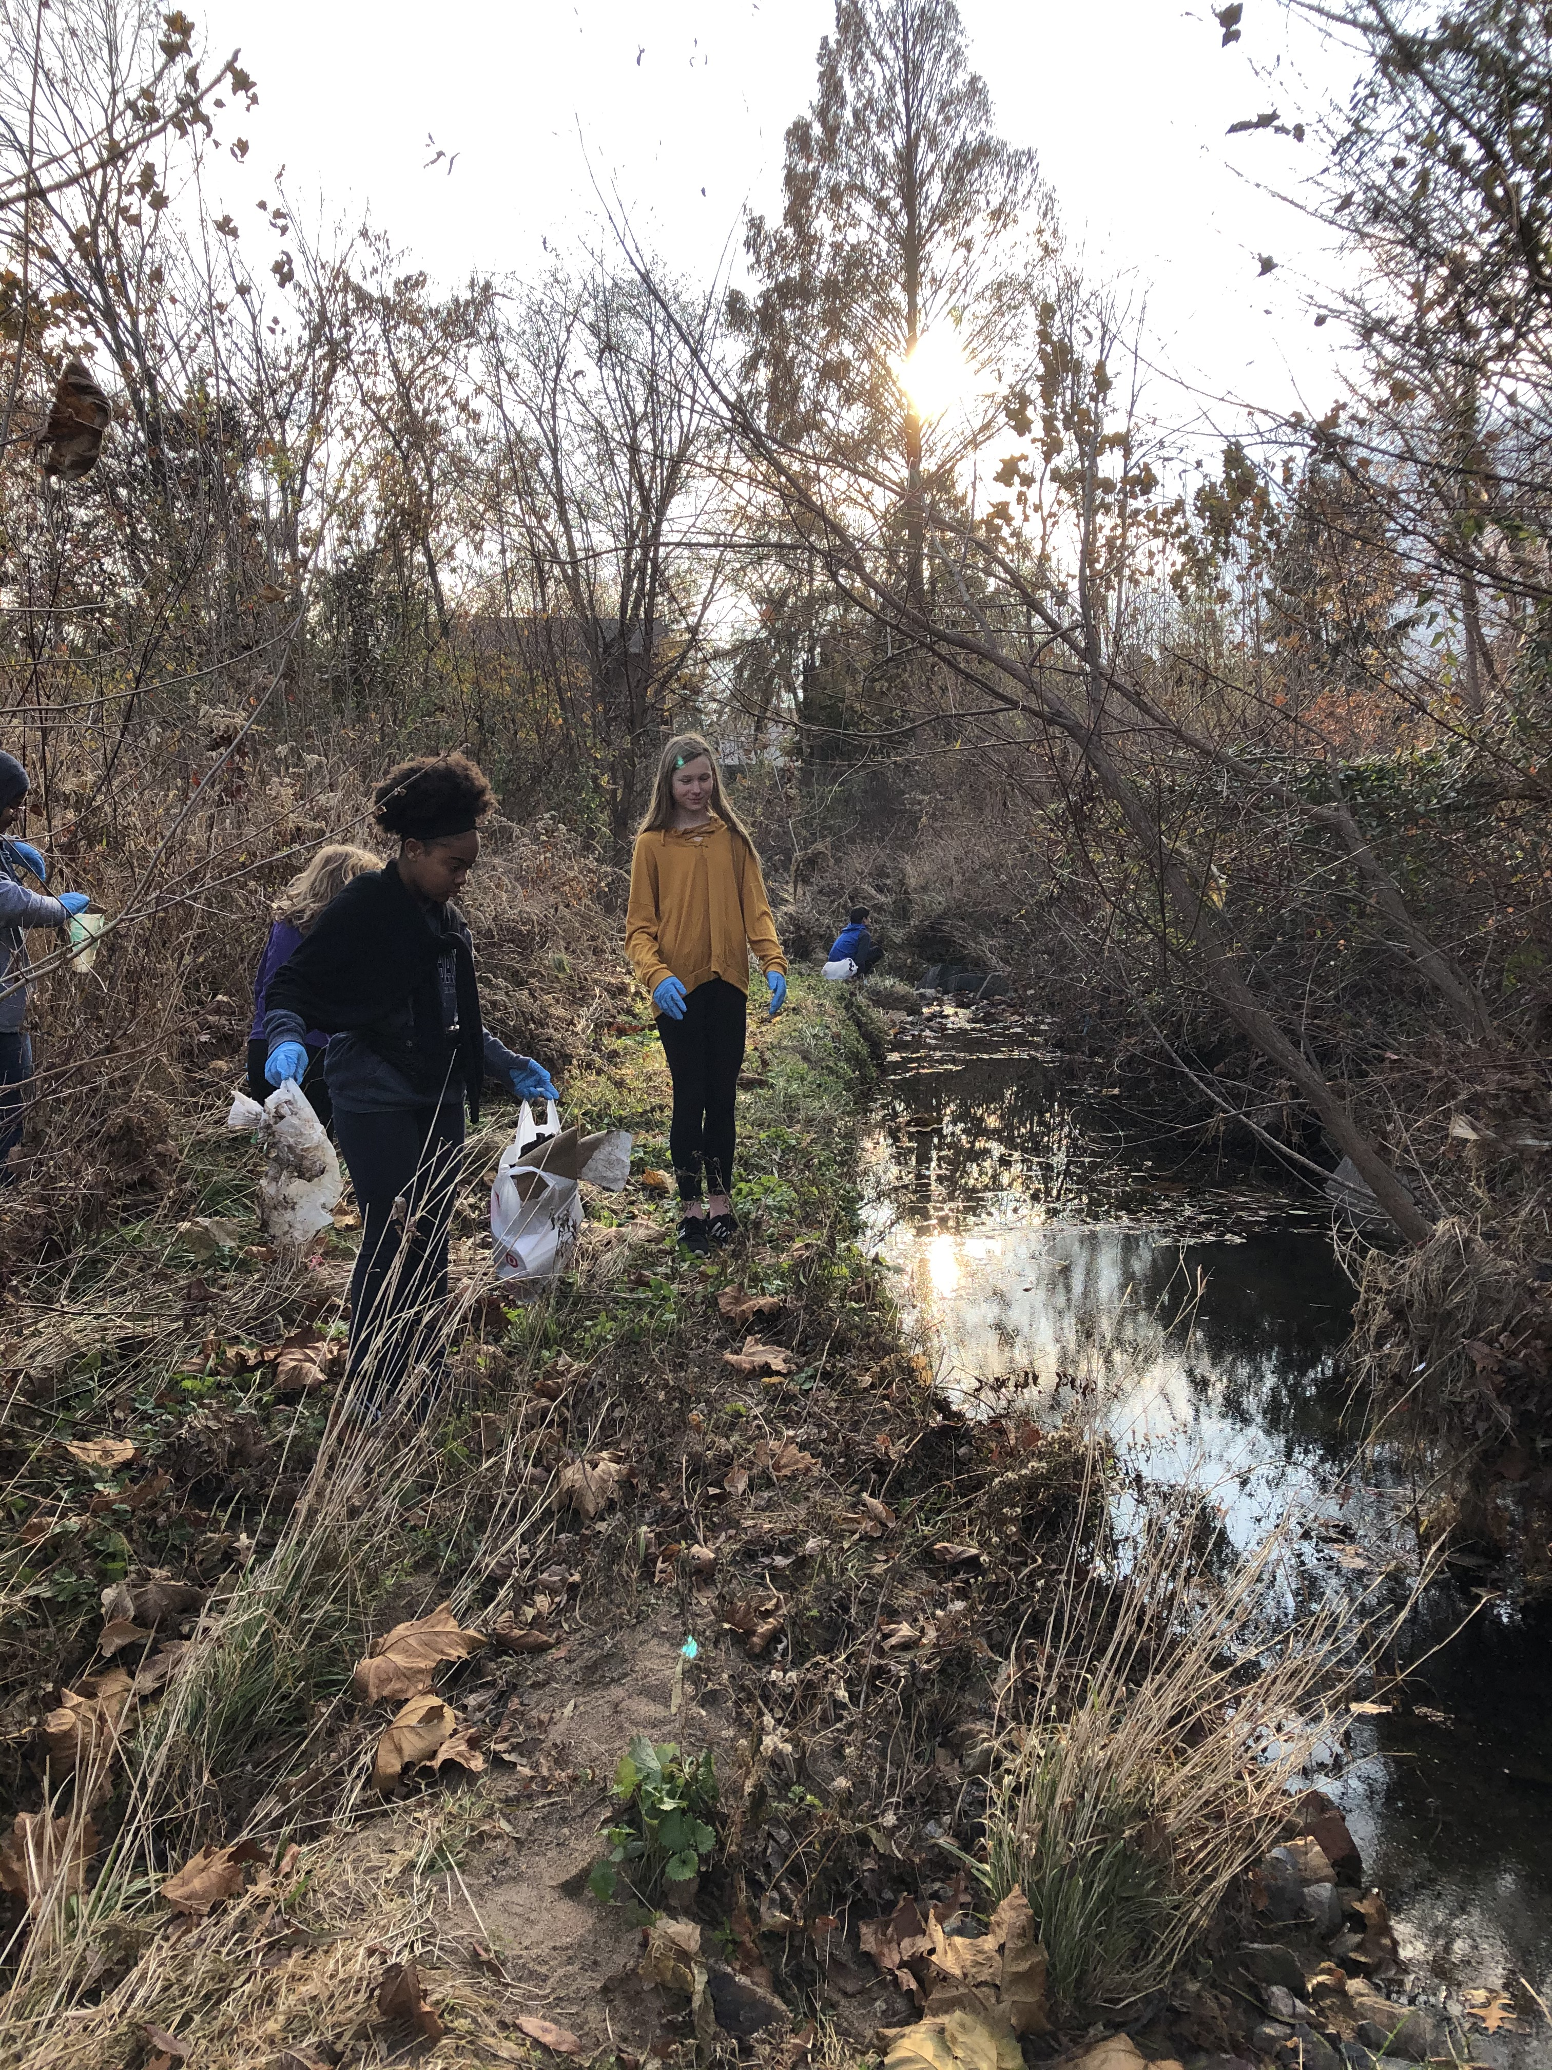

Slide 6
Bird Feeders
12 bird feeders were made and placed around the school yard by the Green Club.
Feeders have been checked and look like some have been eaten.

Slide 7
Future projects
Idle-free Zone (Feb.):
Need help with getting maintenance to put up our one sign
Want to go through advisory for some activities (any ideas?)
Salt Water Run-off (March) – Grim
Earth Day (April) – Everyone
Green club celebration
Advisory activities
Other ideas?

Slide 8
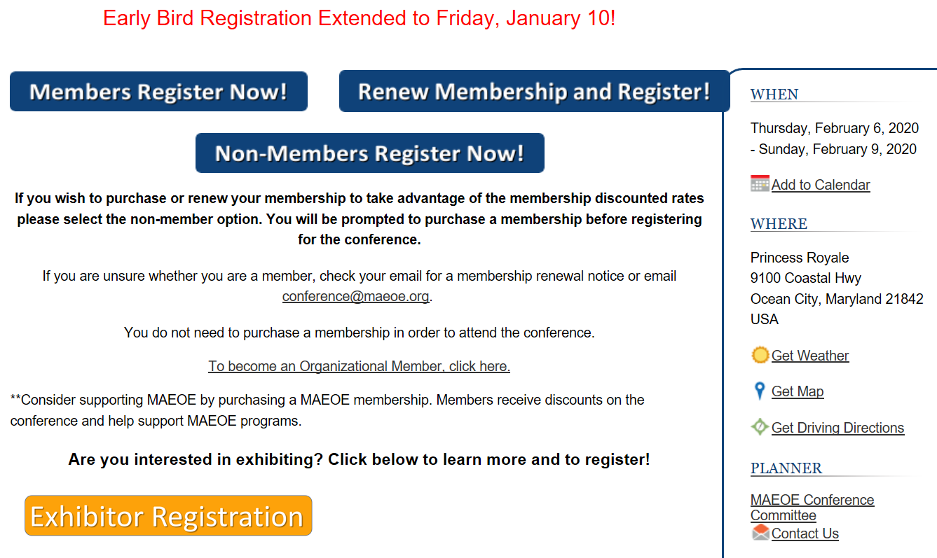
Staff Development opportunities:

